Slide 1
8086 Microprocessor

Slide 2
What is Microprocessor?
Program controlled semiconductor device (IC) which fetches (from memory), decodes and executes instructions.
It is used as CPU (Central Processing Unit) in computers.

Slide 3
Microprocessor
Fifth Generation Pentium
Fourth Generation
During 1980s
Low power version of HMOS technology (HCMOS)
32 bit processors
Physical memory space 2²⁴ bytes = 16 Mb
Virtual memory space 2⁴⁰ bytes = 1 Tb
Floating point hardware
Supports increased number of addressing modes
Intel 80386
Third Generation
During 1978
HMOS technology ⇒ Faster speed, Higher packing density
16 bit processors ⇒ 40/ 48/ 64 pins
Easier to program
Dynamically relatable programs
Processor has multiply/ divide arithmetic hardware
More powerful interrupt handling capabilities
Flexible I/O port addressing
Intel 8086 (16 bit processor)
Second Generation
During 1973
NMOS technology ⇒ Faster speed, Higher density, Compatible with TTL
4 / 8/ 16 bit processors ⇒ 40 pins
Ability to address large memory spaces and I/O ports
Greater number of levels of subroutine nesting
Better interrupt handling capabilities
Intel 8085 (8 bit processor)
First Generation
Between 1971 – 1973
PMOS technology, non compatible with TTL
4 bit processors ⇒ 16 pins
8 and 16 bit processors ⇒ 40 pins
Due to limitations of pins, signals are multiplexed

Slide 4
Functional blocks
Microprocessor
Computational Unit; performs arithmetic and logic operations
Various conditions of the results are stored as status bits called flags in flag register
Internal storage of data
Register array or internal memory
Data Bus
ALU
Generates the address of the instructions to be fetched from the memory and send through address bus to the memory
Flag Register
Instruction decoding unit
Timing and control unit
PC/ IP
Control Bus
Address Bus
Generates control signals for internal and external operations of the microprocessor
Decodes instructions; sends information to the timing and control unit

Slide 5
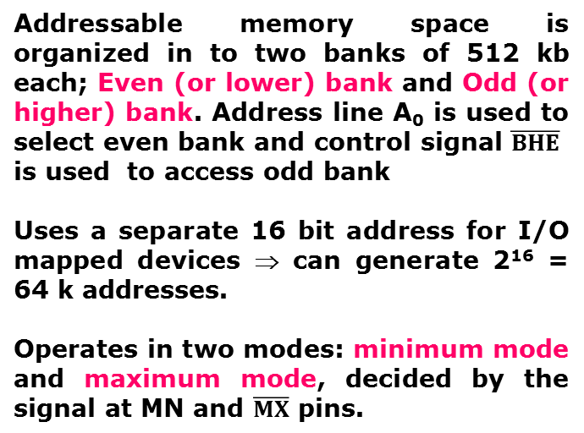
Overview
8086 Microprocessor
First 16- bit processor released by INTEL in the year 1978
Originally HMOS, now manufactured using HMOS III technique
Approximately 29, 000 transistors, 40 pin DIP, 5V supply
Does not have internal clock; external asymmetric clock source with 33% duty cycle
20-bit address to access memory ⇒ can address up to 2²⁰ = 1 megabytes of memory space.
Notes:
DIP- Dual Inline Package

Slide 6
Pins and signals

Slide 7
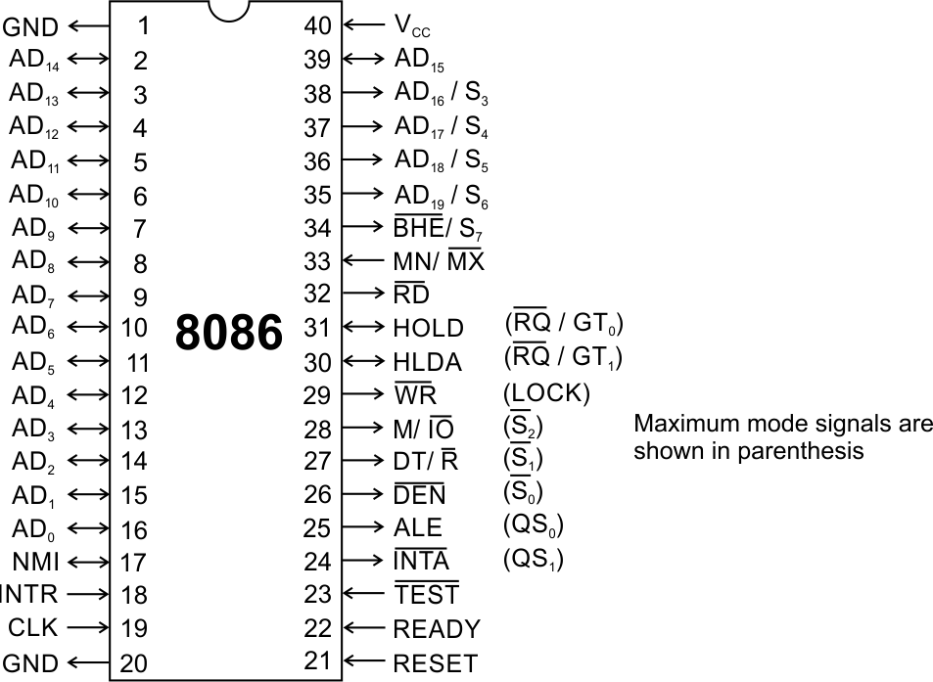
Pins and Signals
8086 Microprocessor
Common signals
AD₀-AD₁₅ (Bidirectional)
Address/Data bus
Low order address bus; these are multiplexed with data.
When AD lines are used to transmit memory address the symbol A is used instead of AD, for example A₀-A₁₅.
When data are transmitted over AD lines the symbol D is used in place of AD, for example D₀-D₇, D₈-D₁₅ or D₀-D₁₅.
A₁₆/S₃, A₁₇/S₄, A₁₈/S₅, A₁₉/S₆
High order address bus. These are multiplexed with status signals

Slide 8
Pins and Signals
8086 Microprocessor
Common signals
BHE (Active Low)/S₇ (Output)
Bus High Enable/Status
It is used to enable data onto the most significant half of data bus, D₈-D₁₅. 8-bit device connected to upper half of the data bus use BHE (Active Low) signal. It is multiplexed with status signal S₇.
MN/ MX
MINIMUM / MAXIMUM
This pin signal indicates what mode the processor is to operate in.
RD (Read) (Active Low)
The signal is used for read operation.
It is an output signal.
It is active when low.

Slide 9
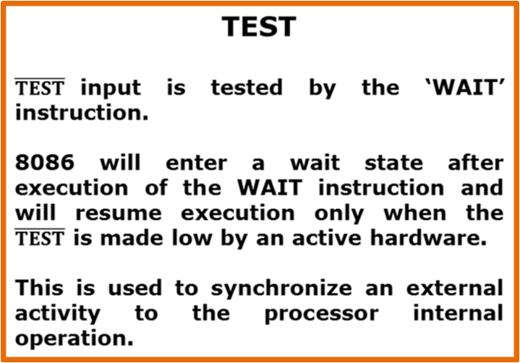
Pins and Signals
8086 Microprocessor
Common signals
READY
This is the acknowledgement from the slow device or memory that they have completed the data transfer.
The signal made available by the devices is synchronized by the 8284A clock generator to provide ready input to the 8086.
The signal is active high.

Slide 10
Pins and Signals
8086 Microprocessor
Common signals
RESET (Input)
Causes the processor to immediately terminate its present activity.
The signal must be active HIGH for at least four clock cycles.
CLK
The clock input provides the basic timing for processor operation and bus control activity. Its an asymmetric square wave with 33% duty cycle.
INTR Interrupt Request
This is a triggered input. This is sampled during the last clock cycles of each instruction to determine the availability of the request. If any interrupt request is pending, the processor enters the interrupt acknowledge cycle.
This signal is active high and internally synchronized.

Slide 11
Pins and Signals
8086 Microprocessor
Min/ Max Pins
The 8086 microprocessor can work in two modes of operations : Minimum mode and Maximum mode.
In the minimum mode of operation the microprocessor do not associate with any co-processors and can not be used for multiprocessor systems.
In the maximum mode the 8086 can work in multi-processor or co-processor configuration.
Minimum or maximum mode operations are decided by the pin MN/ MX(Active low).
When this pin is high 8086 operates in minimum mode otherwise it operates in Maximum mode.

Slide 12
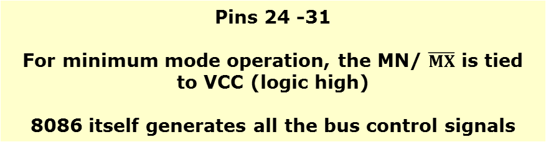





Pins and Signals
8086 Microprocessor
Minimum mode signals
ALE | (Address Latch Enable) Used to demultiplex the address and data lines using external latches

Slide 13
Pins and Signals
8086 Microprocessor
Minimum mode signals
HOLD | Input signal to the processor form the bus masters as a request to grant the control of the bus. Usually used by the DMA controller to get the control of the bus.
HLDA | (Hold Acknowledge) Acknowledge signal by the processor to the bus master requesting the control of the bus through HOLD. The acknowledge is asserted high, when the processor accepts HOLD.

Slide 14
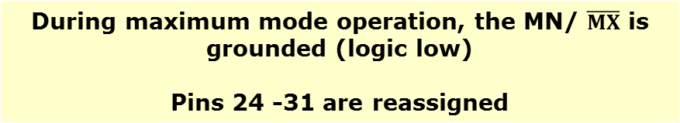
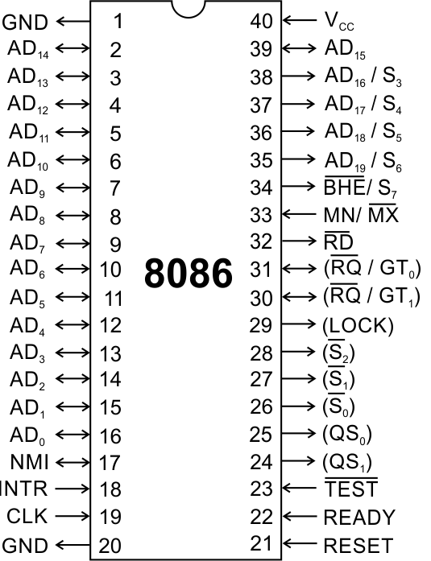
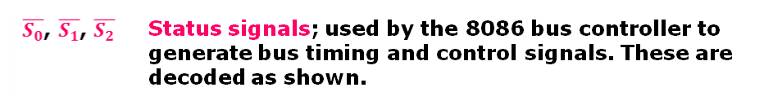
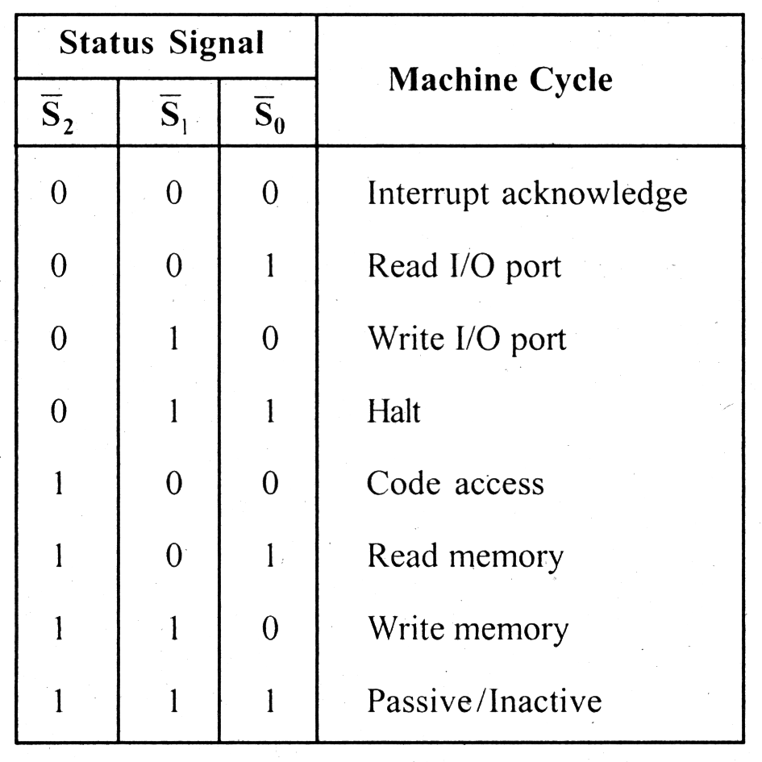
Pins and Signals
8086 Microprocessor
Maximum mode signals

Slide 15
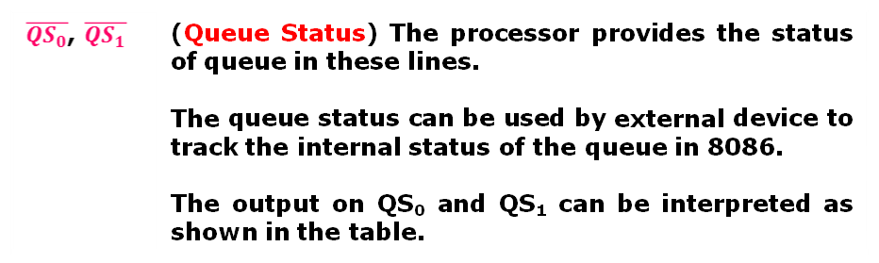
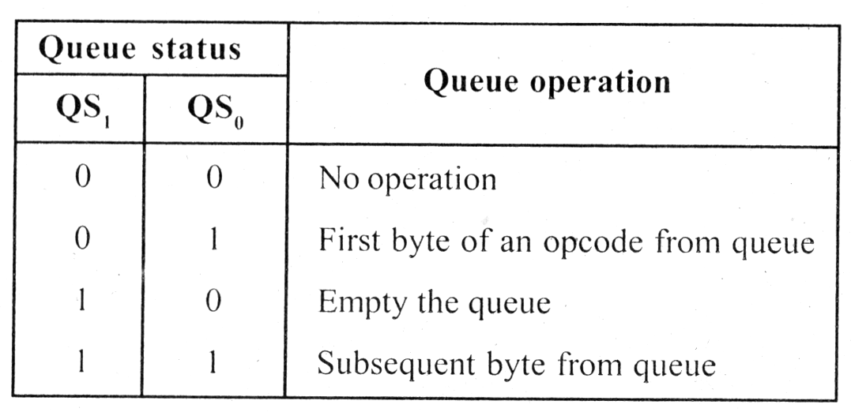
Pins and Signals
8086 Microprocessor
Maximum mode signals

Slide 16
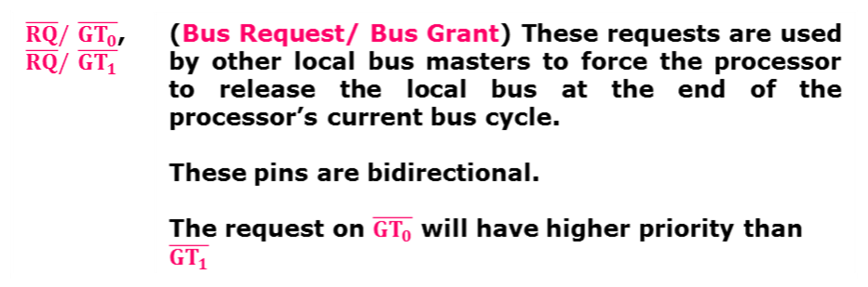
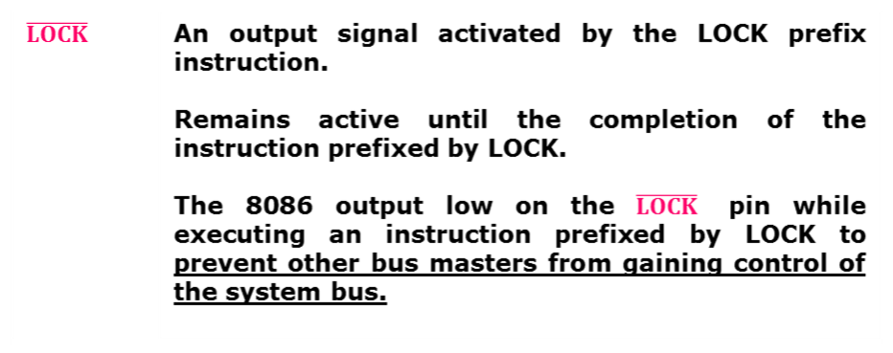
Pins and Signals
8086 Microprocessor
Maximum mode signals

Slide 17
Architecture

Slide 18
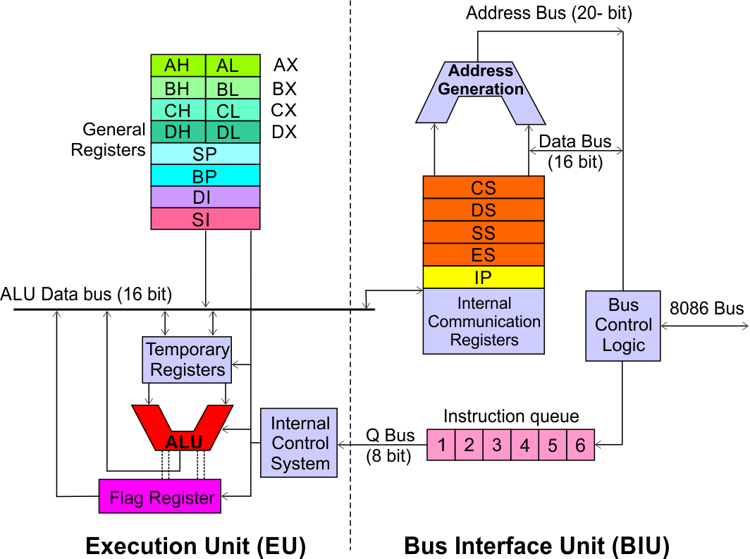
Architecture
8086 Microprocessor
Execution Unit (EU)
EU executes instructions that have already been fetched by the BIU.
BIU and EU functions separately.
Bus Interface Unit (BIU)
BIU fetches instructions, reads data from memory and I/O ports, writes data to memory and I/ O ports.

Slide 19
Architecture
8086 Microprocessor
Bus Interface Unit (BIU)
Dedicated Adder to generate 20 bit address
Four 16-bit segment registers
Code Segment (CS)
Data Segment (DS)
Stack Segment (SS)
Extra Segment (ES)
Segment Registers >>

Slide 20
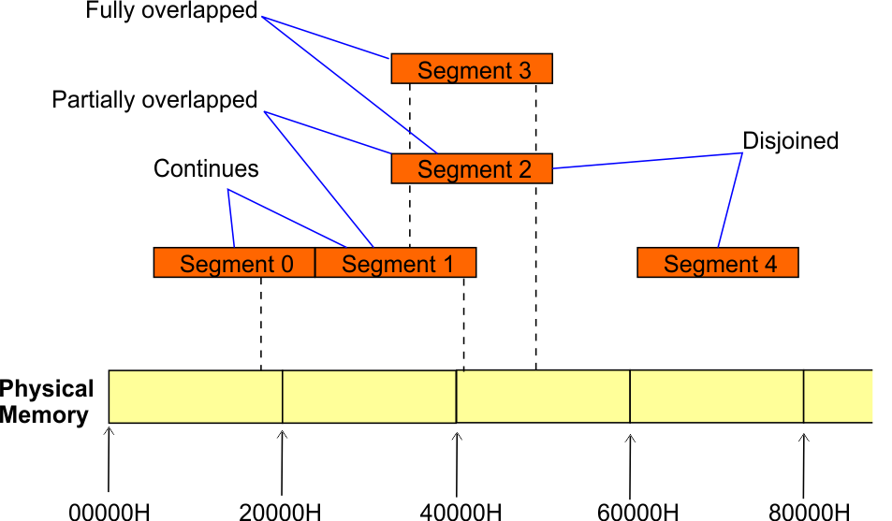
Architecture
8086 Microprocessor
Bus Interface Unit (BIU)
Segment
Registers
8086’s 1-megabyte memory is divided into segments of up to 64K bytes each.
The 8086 can directly address four segments (256 K bytes within the 1 M byte of memory) at a particular time.
Programs obtain access to code and data in the segments by changing the segment register content to point to the desired segments.

Slide 21
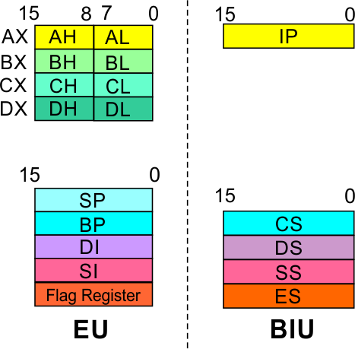
Architecture
8086 Microprocessor
Bus Interface Unit (BIU)
Segment
Registers
Code Segment Register
16-bit
CS contains the base or start of the current code segment; IP contains the distance or offset from this address to the next instruction byte to be fetched.
BIU computes the 20-bit physical address by logically shifting the contents of CS 4-bits to the left and then adding the 16-bit contents of IP.
That is, all instructions of a program are relative to the contents of the CS register multiplied by 16 and then offset is added provided by the IP.

Slide 22
Architecture
8086 Microprocessor
Bus Interface Unit (BIU)
Segment
Registers
Data Segment Register
16-bit
Points to the current data segment; operands for most instructions are fetched from this segment.
The 16-bit contents of the Source Index (SI) or Destination Index (DI) or a 16-bit displacement are used as offset for computing the 20-bit physical address.

Slide 23
Architecture
8086 Microprocessor
Bus Interface Unit (BIU)
Segment
Registers
Stack Segment Register
16-bit
Points to the current stack.
The 20-bit physical stack address is calculated from the Stack Segment (SS) and the Stack Pointer (SP) for stack instructions such as PUSH and POP.
In based addressing mode, the 20-bit physical stack address is calculated from the Stack segment (SS) and the Base Pointer (BP).

Slide 24
Architecture
8086 Microprocessor
Bus Interface Unit (BIU)
Segment
Registers
Extra Segment Register
16-bit
Points to the extra segment in which data (in excess of 64K pointed to by the DS) is stored.
String instructions use the ES and DI to determine the 20-bit physical address for the destination.

Slide 25
Architecture
8086 Microprocessor
Bus Interface Unit (BIU)
Segment
Registers
Instruction Pointer
16-bit
Always points to the next instruction to be executed within the currently executing code segment.
So, this register contains the 16-bit offset address pointing to the next instruction code within the 64Kb of the code segment area.
Its content is automatically incremented as the execution of the next instruction takes place.

Slide 26
Architecture
8086 Microprocessor
Bus Interface Unit (BIU)
Instruction queue
A group of First-In-First-Out (FIFO) in which up to 6 bytes of instruction code are pre fetched from the memory ahead of time.
This is done in order to speed up the execution by overlapping instruction fetch with execution.
This mechanism is known as pipelining.

Slide 27
Architecture
8086 Microprocessor
Execution Unit (EU)
EU decodes and executes instructions.
A decoder in the EU control system translates instructions.
16-bit ALU for performing arithmetic and logic operation
Four general purpose registers(AX, BX, CX, DX);
Pointer registers (Stack Pointer, Base Pointer);
and
Index registers (Source Index, Destination Index) each of 16-bits
Some of the 16 bit registers can be used as two 8 bit registers as :
AX can be used as AH and AL
BX can be used as BH and BL
CX can be used as CH and CL
DX can be used as DH and DL

Slide 28
Architecture
8086 Microprocessor
Execution Unit (EU)
EU
Registers
Accumulator Register (AX)
Consists of two 8-bit registers AL and AH, which can be combined together and used as a 16-bit register AX.
AL in this case contains the low order byte of the word, and AH contains the high-order byte.
The I/O instructions use the AX or AL for inputting / outputting 16 or 8 bit data to or from an I/O port.
Multiplication and Division instructions also use the AX or AL.

Slide 29
Architecture
8086 Microprocessor
Execution Unit (EU)
EU
Registers
Base Register (BX)
Consists of two 8-bit registers BL and BH, which can be combined together and used as a 16-bit register BX.
BL in this case contains the low-order byte of the word, and BH contains the high-order byte.
This is the only general purpose register whose contents can be used for addressing the 8086 memory.
All memory references utilizing this register content for addressing use DS as the default segment register.

Slide 30
Architecture
8086 Microprocessor
Execution Unit (EU)
EU
Registers
Counter Register (CX)
Consists of two 8-bit registers CL and CH, which can be combined together and used as a 16-bit register CX.
When combined, CL register contains the low order byte of the word, and CH contains the high-order byte.
Instructions such as SHIFT, ROTATE and LOOP use the contents of CX as a counter.
Example:
The instruction LOOP START automatically decrements CX by 1 without affecting flags and will check if [CX] = 0.
If it is zero, 8086 executes the next instruction; otherwise the 8086 branches to the label START.

Slide 31
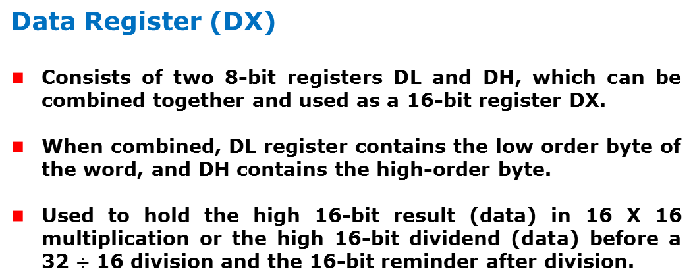
Architecture
8086 Microprocessor
Execution Unit (EU)
EU
Registers

Slide 32
Architecture
8086 Microprocessor
Execution Unit (EU)
EU
Registers
Stack Pointer (SP) and Base Pointer (BP)
SP and BP are used to access data in the stack segment.
SP is used as an offset from the current SS during execution of instructions that involve the stack segment in the external memory.
SP contents are automatically updated (incremented/ decremented) due to execution of a POP or PUSH instruction.
BP contains an offset address in the current SS, which is used by instructions utilizing the based addressing mode.

Slide 33
Architecture
8086 Microprocessor
Execution Unit (EU)
EU
Registers
Source Index (SI) and Destination Index (DI)
Used in indexed addressing.
Instructions that process data strings use the SI and DI registers together with DS and ES respectively in order to distinguish between the source and destination addresses.

Slide 34
Architecture
8086 Microprocessor
Execution Unit (EU)
EU
Registers
Source Index (SI) and Destination Index (DI)
Used in indexed addressing.
Instructions that process data strings use the SI and DI registers together with DS and ES respectively in order to distinguish between the source and destination addresses.

Slide 35
Architecture
8086 Microprocessor
Execution Unit (EU)
Auxiliary Carry Flag
This is set, if there is a carry from the lowest nibble, i.e, bit three during addition, or borrow for the lowest nibble, i.e, bit three, during subtraction.
Carry Flag
This flag is set, when there is a carry out of MSB in case of addition or a borrow in case of subtraction.
Flag Register
Sign Flag
This flag is set, when the result of any computation is negative
Zero Flag
This flag is set, if the result of the computation or comparison performed by an instruction is zero
Parity Flag
This flag is set to 1, if the lower byte of the result contains even number of 1’s ; for odd number of 1’s set to zero.
15 | 14 | 13 | 12 | 11 | 10 | 9 | 8 | 7 | 6 | 5 | 4 | 3 | 2 | 1 | 0
 |  |  |  | OF | DF | IF | TF | SF | ZF |  | AF |  | PF |  | CF
Over flow Flag
This flag is set, if an overflow occurs, i.e, if the result of a signed operation is large enough to accommodate in a destination register. The result is of more than 7-bits in size in case of 8-bit signed operation and more than 15-bits in size in case of 16-bit sign operations, then the overflow will be set.
Tarp Flag
If this flag is set, the processor enters the single step execution mode by generating internal interrupts after the execution of each instruction
Direction Flag
This is used by string manipulation instructions. If this flag bit is ‘0’, the string is processed beginning from the lowest address to the highest address, i.e., auto incrementing mode. Otherwise, the string is processed from the highest address towards the lowest address, i.e., auto incrementing mode.
Interrupt Flag
Causes the 8086 to recognize external mask interrupts; clearing IF disables these interrupts.

Slide 36
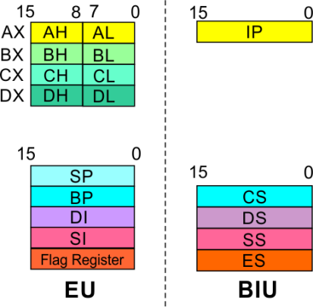
8086 Microprocessor
Architecture
8086 registers categorized into 4 groups
15 | 14 | 13 | 12 | 11 | 10 | 9 | 8 | 7 | 6 | 5 | 4 | 3 | 2 | 1 | 0
 |  |  |  | OF | DF | IF | TF | SF | ZF |  | AF |  | PF |  | CF
Sl.No. | Type | Register width | Name of register
1 | General purpose register | 16 bit | AX, BX, CX, DX
 |  | 8 bit | AL, AH, BL, BH, CL, CH, DL, DH
2 | Pointer register | 16 bit | SP, BP
3 | Index register | 16 bit | SI, DI
4 | Instruction Pointer | 16 bit | IP
5 | Segment register | 16 bit | CS, DS, SS, ES
6 | Flag (PSW) | 16 bit | Flag register

Slide 37
8086 Microprocessor
Architecture
Registers and Special Functions
Register | Name of the Register | Special Function
AX | 16-bit Accumulator | Stores the 16-bit results of arithmetic and logic operations
AL | 8-bit Accumulator | Stores the 8-bit results of arithmetic and logic operations
BX | Base register | Used to hold base value in base addressing mode to access memory data
CX | Count Register | Used to hold the count value in SHIFT, ROTATE and LOOP instructions
DX | Data Register | Used to hold data for multiplication and division operations
SP | Stack Pointer | Used to hold the offset address of top stack memory
BP | Base Pointer | Used to hold the base value in base addressing using SS register to access data from stack memory
SI | Source Index | Used to hold index value of source operand (data) for string instructions
DI | Data Index | Used to hold the index value of destination operand (data) for string operations

Slide 38
ADDRESSING MODES

Slide 39
Introduction
8086 Microprocessor
Program
A set of instructions written to solve a problem.
Instruction
Directions which a microprocessor follows to execute a task or part of a task.
Program is a set of instructions written to solve a problem. Instructions are the directions which a microprocessor follows to execute a task or part of a task. Broadly, computer language can be divided into two parts as high-level language and low level language. Low level language are machine specific. Low level language can be further divided into machine language and assembly language.
Machine language is the only language which a machine can understand. Instructions in this language are written in binary bits as a specific bit pattern. The computer interprets this bit pattern as an instruction to perform a particular task. The entire program is a sequence of binary numbers. This is a machine-friendly language but not user friendly. Debugging is another problem associated with machine language.

Slide 40
Introduction
8086 Microprocessor
To overcome these problems, programmers develop another way in which instructions are written in English alphabets. This new language is known as Assembly language. The instructions in this language are termed Mnemonics. As microprocessor can only understand the machine language so mnemonics are translated into machine language either manually or by a program known as Assembler.
Efficient software development for the microprocessor requires a complete familiarity with the instruction set, their format and addressing modes. Here in this chapter, we will focus on the addressing modes and instructions formats of microprocessor 8086.

Slide 41
Addressing Modes
8086 Microprocessor
Every instruction of a program has to operate on a data.
The different ways in which a source operand is denoted in an instruction are known as addressing modes.
Register Addressing
Immediate Addressing
Direct Addressing
Register Indirect Addressing
Based Addressing
Indexed Addressing
Based Index Addressing
String Addressing
Direct I/O port Addressing
10. Indirect I/O port Addressing
11. Relative Addressing
12. Implied Addressing
Group I : Addressing modes for register and immediate data
Group II : Addressing modes for memory data
Group III : Addressing modes for I/O ports
Group IV : Relative Addressing mode
Group V : Implied Addressing mode

Slide 42
Addressing Modes
8086 Microprocessor
Group I : Addressing modes for register and immediate data
Register Addressing
Immediate Addressing
Direct Addressing
Register Indirect Addressing
Based Addressing
Indexed Addressing
Based Index Addressing
String Addressing
Direct I/O port Addressing
10. Indirect I/O port Addressing
11. Relative Addressing
12. Implied Addressing
The instruction will specify the name of the register which holds the data to be operated by the instruction.
Example:
MOV CL, DH
The content of 8-bit register DH is moved to another 8-bit register CL
(CL) ← (DH)

Slide 43

Addressing Modes
8086 Microprocessor
Group I : Addressing modes for register and immediate data
Register Addressing
Immediate Addressing
Direct Addressing
Register Indirect Addressing
Based Addressing
Indexed Addressing
Based Index Addressing
String Addressing
Direct I/O port Addressing
10. Indirect I/O port Addressing
11. Relative Addressing
12. Implied Addressing
In immediate addressing mode, an 8-bit or 16-bit data is specified as part of the instruction
Example:
MOV DL, 08H
The 8-bit data (08_{H}) given in the instruction is moved to DL
(DL) ← 08_{H}
MOV AX, 0A9FH
The 16-bit data (0A9F_{H}) given in the instruction is moved to AX register
(AX) ← 0A9F_{H}

Slide 44
Addressing Modes : Memory Access
8086 Microprocessor
Offset Value (16 bits)
Segment Register (16 bits)
0 0 0 0
Adder
Physical Address (20 Bits)

Slide 45
Addressing Modes : Memory Access
8086 Microprocessor
20 Address lines ⇒ 8086 can address up to 2²⁰ = 1M bytes of memory
However, the largest register is only 16 bits
Physical Address will have to be calculated Physical Address : Actual address of a byte in memory. i.e. the value which goes out onto the address bus.
Memory Address represented in the form – Seg : Offset (Eg - 89AB:F012)
Each time the processor wants to access memory, it takes the contents of a segment register, shifts it one hexadecimal place to the left (same as multiplying by 16₁₀), then add the required offset to form the 20- bit address
16 bytes of contiguous memory
89AB : F012 → 89AB → 89AB0 (Paragraph to byte → 89AB x 10 = 89AB0)
F012 → 0F012 (Offset is already in byte unit)
+ -------
98AC2 (The absolute address)

Slide 46
Addressing Modes : Memory Access
8086 Microprocessor
To access memory we use these four registers: BX, SI, DI, BP
Combining these registers inside [ ] symbols, we can get different memory locations (Effective Address, EA)
Supported combinations:
[BX + SI] [BX + DI] [BP + SI] [BP + DI] | [SI] [DI] d16 (variable offset only) [BX] | [BX + SI + d8] [BX + DI + d8] [BP + SI + d8] [BP + DI + d8]
[SI + d8] [DI + d8] [BP + d8] [BX + d8] | [BX + SI + d16] [BX + DI + d16] [BP + SI + d16] [BP + DI + d16] | [SI + d16] [DI + d16] [BP + d16] [BX + d16]
BX BP | SI DI | + disp

Slide 47
Addressing Modes
8086 Microprocessor
Group II : Addressing modes for memory data
Register Addressing
Immediate Addressing
Direct Addressing
Register Indirect Addressing
Based Addressing
Indexed Addressing
Based Index Addressing
String Addressing
Direct I/O port Addressing
10. Indirect I/O port Addressing
11. Relative Addressing
12. Implied Addressing
Here, the effective address of the memory location at which the data operand is stored is given in the instruction.
The effective address is just a 16-bit number written directly in the instruction.
Example:
MOV BX, [1354H]
MOV BL, [0400H]
The square brackets around the 1354_{H} denotes the contents of the memory location. When executed, this instruction will copy the contents of the memory location into BX register.
This addressing mode is called direct because the displacement of the operand from the segment base is specified directly in the instruction.

Slide 48
Addressing Modes
8086 Microprocessor
Group II : Addressing modes for memory data
Register Addressing
Immediate Addressing
Direct Addressing
Register Indirect Addressing
Based Addressing
Indexed Addressing
Based Index Addressing
String Addressing
Direct I/O port Addressing
10. Indirect I/O port Addressing
11. Relative Addressing
12. Implied Addressing
In Register indirect addressing, name of the register which holds the effective address (EA) will be specified in the instruction.
Registers used to hold EA are any of the following registers:
BX, BP, DI and SI.
Content of the DS register is used for base address calculation.
Example:
MOV CX, [BX]
Operations:
    EA = (BX)
    BA = (DS) x 16₁₀
    MA = BA + EA
    (CX) ← (MA) or,
    (CL) ← (MA)
    (CH) ← (MA +1)
Note : Register/ memory enclosed in brackets refer to content of register/ memory

Slide 49
Addressing Modes
8086 Microprocessor
Group II : Addressing modes for memory data
Register Addressing
Immediate Addressing
Direct Addressing
Register Indirect Addressing
Based Addressing
Indexed Addressing
Based Index Addressing
String Addressing
Direct I/O port Addressing
10. Indirect I/O port Addressing
11. Relative Addressing
12. Implied Addressing
In Based Addressing, BX or BP is used to hold the base value for effective address and a signed 8-bit or unsigned 16-bit displacement will be specified in the instruction.
In case of 8-bit displacement, it is sign extended to 16-bit before adding to the base value.
When BX holds the base value of EA, 20-bit physical address is calculated from BX and DS.
When BP holds the base value of EA, BP and SS is used.
Example:
MOV AX, [BX + 08H]
Operations:
    0008_{H} ← 08_{H} (Sign extended)
    EA = (BX) + 0008_{H}
    BA = (DS) x 16₁₀
    MA = BA + EA
    (AX) ← (MA) or,
    (AL) ← (MA)
    (AH) ← (MA + 1)

Slide 50
Addressing Modes
8086 Microprocessor
Group II : Addressing modes for memory data
Register Addressing
Immediate Addressing
Direct Addressing
Register Indirect Addressing
Based Addressing
Indexed Addressing
Based Index Addressing
String Addressing
Direct I/O port Addressing
10. Indirect I/O port Addressing
11. Relative Addressing
12. Implied Addressing
SI or DI register is used to hold an index value for memory data and a signed 8-bit or unsigned 16-bit displacement will be specified in the instruction.
Displacement is added to the index value in SI or DI register to obtain the EA.
In case of 8-bit displacement, it is sign extended to 16-bit before adding to the base value.
Example:
MOV CX, [SI + 0A2H]
    Operations:
      FFA2_{H} ← A2_{H} (Sign extended)
      EA = (SI) + FFA2_{H}
      BA = (DS) x 16₁₀
      MA = BA + EA
      (CX) ← (MA) or,
      (CL) ← (MA)
      (CH) ← (MA + 1)

Slide 51
Addressing Modes
8086 Microprocessor
Group II : Addressing modes for memory data
Register Addressing
Immediate Addressing
Direct Addressing
Register Indirect Addressing
Based Addressing
Indexed Addressing
Based Index Addressing
String Addressing
Direct I/O port Addressing
10. Indirect I/O port Addressing
11. Relative Addressing
12. Implied Addressing
In Based Index Addressing, the effective address is computed from the sum of a base register (BX or BP), an index register (SI or DI) and a displacement.
Example:
MOV DX, [BX + SI + 0AH]
    Operations:
      000A_{H} ← 0A_{H} (Sign extended)
      EA = (BX) + (SI) + 000A_{H}
      BA = (DS) x 16₁₀
      MA = BA + EA
      (DX) ← (MA) or,
      (DL) ← (MA)
      (DH) ← (MA + 1)

Slide 52
Addressing Modes
8086 Microprocessor
Group II : Addressing modes for memory data
Register Addressing
Immediate Addressing
Direct Addressing
Register Indirect Addressing
Based Addressing
Indexed Addressing
Based Index Addressing
String Addressing
Direct I/O port Addressing
10. Indirect I/O port Addressing
11. Relative Addressing
12. Implied Addressing
Employed in string operations to operate on string data.
The effective address (EA) of source data is stored in SI register and the EA of destination is stored in DI register.
Segment register for calculating base address of
source data is DS and that of the destination data is ES
    Example: MOVS BYTE
Operations:
Calculation of source memory location:
EA = (SI) BA = (DS) x 16₁₀ MA = BA + EA
Calculation of destination memory location:
EA_{E} = (DI) BA_{E} = (ES) x 16₁₀ MA_{E} = BA_{E} + EA_{E}
(MAE) ← (MA)
If DF = 1, then (SI) ← (SI) – 1 and (DI) = (DI) - 1
If DF = 0, then (SI) ← (SI) +1 and (DI) = (DI) + 1
Note : Effective address of the Extra segment register

Slide 53
Addressing Modes
8086 Microprocessor
Group III : Addressing modes for I/O ports
Register Addressing
Immediate Addressing
Direct Addressing
Register Indirect Addressing
Based Addressing
Indexed Addressing
Based Index Addressing
String Addressing
Direct I/O port Addressing
10. Indirect I/O port Addressing
11. Relative Addressing
12. Implied Addressing
These addressing modes are used to access data from standard I/O mapped devices or ports.
In direct port addressing mode, an 8-bit port address is directly specified in the instruction.
    Example: IN AL, [09H]
Operations: PORT_{addr} = 09_{H}
(AL) ← (PORT)
Content of port with address 09_{H} is moved to AL register
In indirect port addressing mode, the instruction will specify the name of the register which holds the port address. In 8086, the 16-bit port address is stored in the DX register.
    Example: OUT [DX], AX
Operations: PORT_{addr} = (DX)
(PORT) ← (AX)
Content of AX is moved to port whose address is specified by DX register.

Slide 54
Addressing Modes
8086 Microprocessor
Group IV : Relative Addressing mode
Register Addressing
Immediate Addressing
Direct Addressing
Register Indirect Addressing
Based Addressing
Indexed Addressing
Based Index Addressing
String Addressing
Direct I/O port Addressing
10. Indirect I/O port Addressing
11. Relative Addressing
12. Implied Addressing
In this addressing mode, the effective address of a program instruction is specified relative to Instruction Pointer (IP) by an 8-bit signed displacement.
Example: JZ 0AH
Operations:
  000A_{H} ← 0A_{H} (sign extend)
  If ZF = 1, then
  EA = (IP) + 000A_{H}
  BA = (CS) x 16₁₀
  MA = BA + EA
  If ZF = 1, then the program control jumps to new address calculated above.
  If ZF = 0, then next instruction of the program is executed.

Slide 55
Addressing Modes
8086 Microprocessor
Group IV : Implied Addressing mode
Register Addressing
Immediate Addressing
Direct Addressing
Register Indirect Addressing
Based Addressing
Indexed Addressing
Based Index Addressing
String Addressing
Direct I/O port Addressing
10. Indirect I/O port Addressing
11. Relative Addressing
12. Implied Addressing
Instructions using this mode have no operands. The instruction itself will specify the data to be operated by the instruction.
Example: CLC
This clears the carry flag to zero.

